Slide 1
Welcome!
Please, have a seat.
CWRU Quants
quants@case.edu
Notes:
Christo

Slide 2
Agenda
Roadmap
The Field of Market Microstructure
Market Structure
Price Discovery
Market Friction
Liquidity
Breakout into Project Groups
Notes:
Christo

Slide 3

Attendance | CampusGroups
Notes:
Christo

Slide 4

Discord (important!)
Notes:
Christo

Slide 5
Roadmap
Date | Meeting | Meeting Type
1/17 | Project Group Formation | Projects
1/24 | Market Microstructure + Projects | Educational
1/31 | Project Work Session | Projects
2/7 | Guest Speaker Talk – Jump Trading | Guest Speaker
2/14 | Interview Preparation | Educational
2/21 | Project Work Session | Projects
2/28 | Social Event | Social
3/7 | Project Work Session | Projects
Spring Break
Trading real funds?
Networking event with other startup quant clubs?
More guest speakers?
Notes:
https://www.acsu.buffalo.edu/~keechung/MGF743/Readings/Hans%20Stoll,%202003,%20Market%20microstructure.pdf

Slide 6
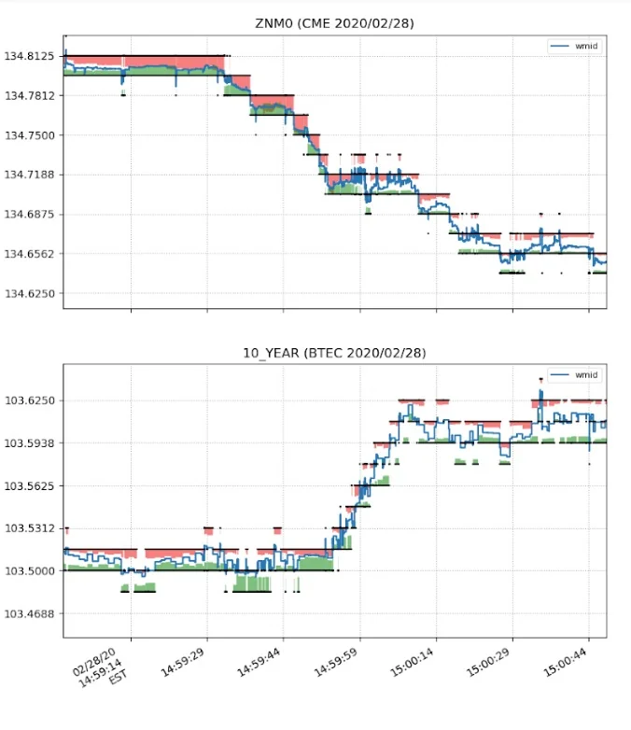
Market Microstructure
Notes:
Christo

Slide 7
What is market microstructure?
According to the National Bureau of Economic Research, market microstructure “focuses on theoretical, empirical, and experimental research on the economics of security markets”.
Put simply, it’s the study of how markets (and market participants) work.
As we know, markets tend to a stable equilibrium price in theory
Market microstructure studies the factors that affect this tendency toward equilibrium.
For example, volatility of the tendency, information asymmetry changing the equilibrium price outright, etc.
This is a research topic, so if this interests you, you should talk to Sidharth about the education vertical!
Notes:
Christo

Slide 8
Why do we care?
Understanding market microstructure is integral to understanding asset pricing
Market microstructure studies:
liquidity
slippage
transaction costs
volatility
and other factors that influence the psychology of market participants
who ultimately drive asset prices with their decisions to trade (or not trade!)
Notes:
Christo

Slide 9
That’s not all…
Proper understanding of market microstructure is oil for the gears of any serious trading algorithm, high-frequency or not.
Trading algorithms (generally) work by taking a view on the price of an asset and trading that view. An asset pricing model is used to develop that view
Market microstructure insights are used to extract information from asset price patterns, and that information can be an input for the algorithm
On the trade execution side, understanding volatility, slippage, and the effects of transaction costs can help an algorithm trade efficiently and minimize performance drag due to friction.
Notes:
Christo

Slide 10
Market Microstructure and Your Orders
According to Stoll:
Traders in financial markets are actually participants in 3 different markets – the market for information, the market for securities, and the market for transaction services
Market microstructure is interested primarily in the market for transaction services
Each market has its own transaction costs
Transaction services -> bid-ask spread, commissions
Securities -> “friction” in asset pricing
Information -> costs depend on information asymmetry
When you trade, your order type shows your immediacy preference
Market orders -> broker is ordered to trade immediately at the best price
high need for immediacy, you pay for this in sub-optimal fills
Limit orders -> your order waits until the order price becomes the best price
low need for immediacy, your order could supply immediacy for someone’s market order
But who are these “someone”s in the market?
Notes:
https://www.acsu.buffalo.edu/~keechung/MGF743/Readings/Hans%20Stoll,%202003,%20Market%20microstructure.pdf

Slide 11
Market Participants
Investors – Those who transact to express market views. Can be divided into:
Active (predominantly market orders, push markets in their direction) and passive (predominantly limit orders, stabilize markets)
Liquidity (trade to alter their risk profile) and informed (trade based on private information about an asset)
Institutional (pension funds, mutual funds, endowments, etc) and individual (retail)
Public (trade through a broker) and professional (trade for themselves as market makers or on the trading floor)
Brokers – Those who facilitate trading
For investors – “upstairs” brokers
On the trading floor – “downstairs” brokers
Dealers – Those who maintain liquidity. Typically traders of their own accounts who profit from the difference between buying and selling (bid-ask spread)
A notable example of a dealer is a market maker
Notes:
Ray
https://www.reddit.com/user/modern_football/

Slide 12
Costs in transaction services markets
When you trade, four things happen:
The trader uses price information (current and historical) to determine or influence their action
Once the order is placed, it gets routed from your broker to an exchange. For example, a trade may go from being placed on Robinhood to the NYSE via the Designated Turnaround System, an electronic trade router. Your broker might get paid for this service
The trade then gets executed at an exchange. Exchanges use complicated techniques to decide how long to wait for before executing an order that comes in, to avoid being taken advantage of by traders with information advantages
Finally, trades have to be cleared and settled, which just means that the buying and selling brokers have to check their books and make sure that they agree on the nature of all transactions made between them
The broker has to work to make all of this possible, and they are compensated for this in commissions
Notes:
Ray

Slide 13
The Bid-Ask Spread as a Transaction Cost
Liquidity suppliers incur several costs and risks as part of their operations:
Order handling costs (costs for all actions enumerated in previous slide)
Inventory risk
By placing a limit order, the supplier of immediacy incurs the risk of being forced to take on an inventory of shares at a suboptimal price. Ex. stock trades at $12, you set a limit buy at $10, but due to illiquidity/volatility/whatever the buy order could execute at $10 while the stock is at $9, leaving you with an immediate unrealized loss
Giving additional optionality to the rest of the market
By placing a limit order, you give the market the option to trade based on the new information your order offers before you can change your order
Potential of asymmetric information
In negotiations, “whoever speaks first loses”
For these risks and costs, they are compensated with the losses that traders incur due to the bid-ask spread
Notes:
Christo

Slide 14

Market Structure
Notes:
Transition

Slide 15
What is market structure?
Market structure is simply the rules that govern trading in a market.
These rules can include:
tick sizes
lot sizes
policies around order execution information disclosure
etc
The goal of market structure is to maximize operational efficiency, resilience, and investor confidence
Market structure can affect transaction fees and liquidity
Notes:
https://www.sifma.org/explore-issues/equity-market-structure/

Slide 16
Types of Markets
Most real-world markets incorporate aspects of:
A pure auction market – investors trade with each other without any dealer intervention. Investors may or may not be represented by brokers
A call auction market – the market only exists at certain times when the security is “called” for trading. As Stoll puts it:
“investors place orders – prices and quantities – which are traded at a specific time according to specific rules, usually at a single market clearing price. For example, the NYSE opens with a kind of call auction market in which the clearing price is set to maximize the volume of trade at the opening.”
A continuous auction market – investors trade against floor brokers and earlier standing orders. This is the model the NYSE follows most closely
A dealer market – investors trade purely against dealer-posted bids and asks, and never against each other. The NASDAQ started off following this model
Notes:
Christo

Slide 17
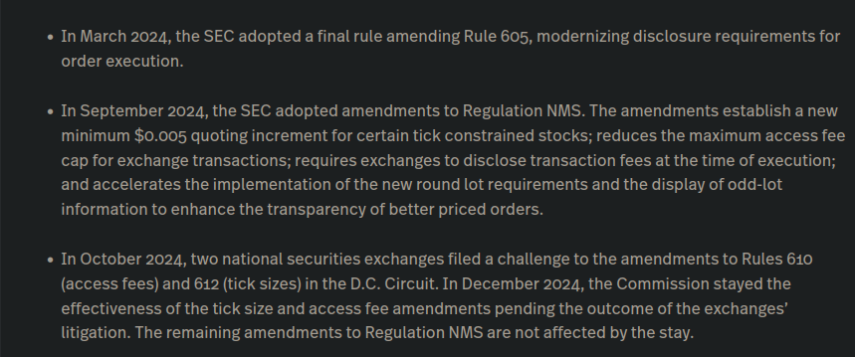
Recent Developments

Slide 18
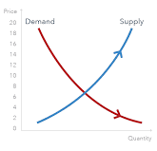
Price Discovery
Notes:
Christo

Slide 19
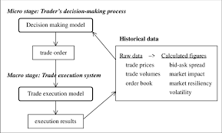
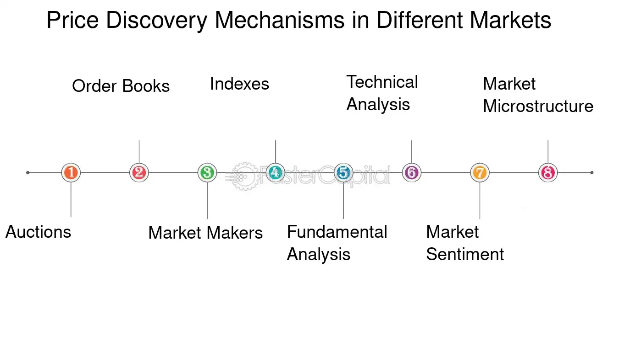
What is price discovery?
Financial markets offer the opportunity for a wide variety of economic agents to express their economic expectations.
The resulting price-discovery process reflects the agents’ respective levels of information and investment capacities.
Manager vs External Financial Markets (Asymmetric information): Manager will always have more information then the market, may deceive the market accordingly (PRINCIPAL-AGENT PROBLEM)
Notes:
Christo
Microstructure and high-frequency price discovery in the soybean complex - ScienceDirect

Slide 20
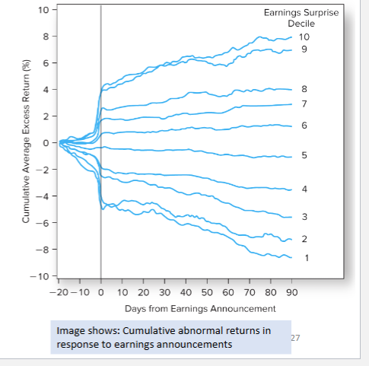
How are instruments priced?
In the short run, the prices of financial instruments may deviate from their fundamental value on account of microstructure frictions such as bid–ask bounce, inventory control and order imbalances.
Other models were quite simple: they assumed that the price impact of a trade was immediate. In reality, this is not always so, and there may be lagged effects or slow adjustments.
Price discovery is the point at which a buyer and a seller agree on a price and a transaction occurs (even if it is not theoretically correct(!))
Remember—for any trade to happen, there must be (1) a buyer and (2) a seller
If a bidder did not know what prices were being offered by other buyers, it would be impossible to establish a fair price for any participant.
Notes:
Price discovery (Chapter 9) - The Microstructure of Financial Markets
What Is Price Discovery? Definition, Process, and vs. Valuation

Slide 21
Conflicts between Shareholders
Managers care about: Compensations & Perks & Entrenchment (More job security) & Empire-Building (The more projects you are involved with i.e. M&A)
Managers are board of directors, c-suite, etc.
Shareholders care about: Market Value of Equity (PV of future CF to SH not FCF)
Shareholders don’t care about firm value, only shareholder value
They contribute through equity and endeavor to maximize share price
Bondholders care about: Market value of debt (PV of future CF to bondholders not FCF)
Bondholders are when managers raise money through other investors
Interest will try and be minimized for long/short term debt
Notes:
Christo
Microstructure and high-frequency price discovery in the soybean complex - ScienceDirect

Slide 22
Game of Information?
People with different claims to the company have different risk preferences (tolerances)
Bondholders have nothing to gain except get the interest payments on time (risk averse)
Shareholders can only lose what they put in but have theoretically infinite gain (more risky)
Managers versus financial markets (Manager knows more about the company than anyone else, but if false info is given the market will eventually learn and stop believing)
Giving false information at their options come time for vesting (so they can sell at inflated prices)
Stock Options: Managers will just sell and not be interested in short-term value to stakeholders.
Notes:
Price discovery (Chapter 9) - The Microstructure of Financial Markets

Slide 23
Market Friction
Notes:
Christo

Slide 24
Market Friction
Market Friction: anything that interferes with trade, financial market frictions can exist even in efficient markets. Some Examples are:
Transactions costs, taxes and regulations, asset indivisibility, non traded assets, and agency and information problems.
For theoretically perfect market arbitrage to work, there can be no market friction.
Adverse Selection: Markets where adverse selection can lead to market failure are those where the “bad risks” end up being the participants in the market, because the “good risks” get “pushed out” of or leave the market because market prices won’t reflect their willingness to pay/sell
Notes:
Financial Market Frictions - Federal Reserve Bank of Atlanta

Slide 25
Solutions?
Signaling: Action taken by the informed party to reveal private information to the uninformed party (e.g. firms advertise, laborers get college degree, drivers choose high deductible)
Effective signaling is costly. The better my signal (which can be costly), the more beneficial that signal will be (e.g. a degree from CWRU indicates high quality, so you are even more open to revealing your education from CWRU. Otherwise you might hide info.
Screening: Action taken by the uninformed party to induce an informed party to reveal information (e.g. banks screen you with income info before lend money, seller of car insurance determines premium by accidents, buyers of used carfax (intermediary solution)
Notes:
Christo
Microstructure and high-frequency price discovery in the soybean complex - ScienceDirect

Slide 26
Trade execution?
Execution is the completion of a buy or sell order for a security. The execution of an order occurs when it gets filled, not when the investor places it. When the investor submits the trade, it is sent to a broker, who then determines the best way for it to be executed.
Viper Algorithm: Helps clients when they want to be aggressive with their FX trades and get out of risky positions fast
Chameleon Algorithm: Best for executing larger transactions because it allows clients to dribble out their trades without creating too much gyration in prices
Iguana Algorithm: Helps clients that know they want to execute a certain trade within a specific time horizon but need help deciding when it’s best to pull it off
Notes:
Christo
Algorithms Like Viper Devour Trades in New FX Era: Big Take - Bloomberg
Execution: Definition, Types of Orders, Examples

Slide 27
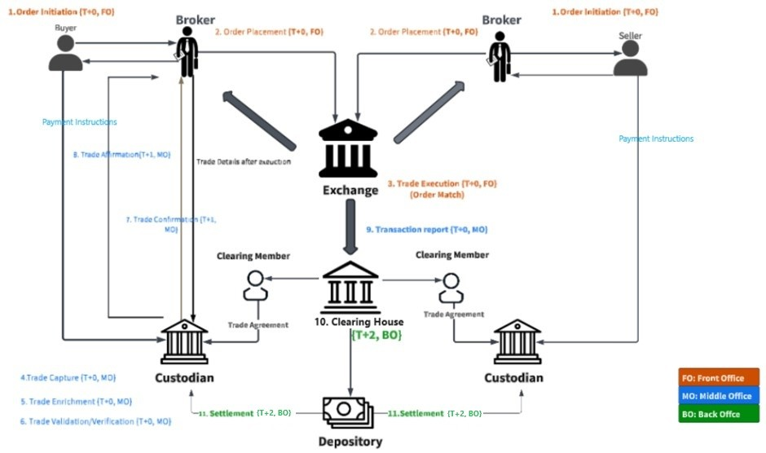
Trade Lifecycle
Notes:
Price discovery (Chapter 9) - The Microstructure of Financial Markets

Slide 28
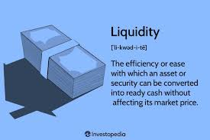
Liquidity
Notes:
Christo

Slide 29
Liquidity
Liquidity: Liquidity measures the ease in which you can convert an asset/security into cash without affecting its market price (Investopedia)
We can extend this measure to a market is liquid
E.g. the stock market has much higher market liquidity than the market for rare books
It’s important to understand liquidity because an asset being less liquid represents another type of ``friction” that can occur when trading with it
Liquidity risk - the possibility an institution will be unable to obtain funds to meet financial obligations
Notes:
Financial Market Frictions - Federal Reserve Bank of Atlanta

Slide 30
Modeling Liquidity Risk
It is important to demonstrate resilience in the presence of liquidity risk because (a) it represents a major financial threat to banks and (b) it is legally required by the SEC and the Federal Reserve.
In the past, we’ve drawn our models from physics and chemistry, but today we borrow from epidemiology. This specific model represents how, when one bank experience liquidity shortages, other banks will withdraw their funds. This leads to a domino effect.
Notes:
Christo
Microstructure and high-frequency price discovery in the soybean complex - ScienceDirect

Slide 31
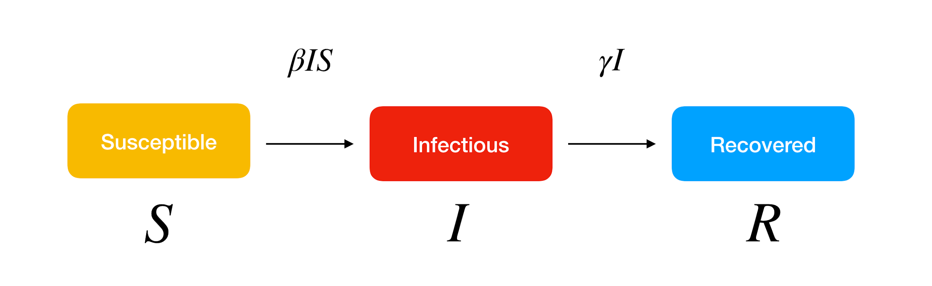
SIR Model

Slide 32
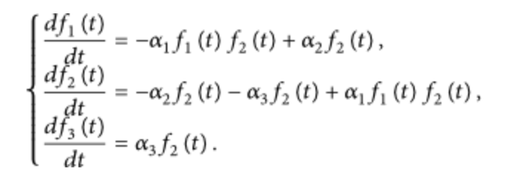
SIR Model….for Liquidity Contagion
“Damaged” Banks
Bankrupt
Banks
Banks

Slide 33
Volatility
Notes:
Christo

Slide 34
Volatility
Volatility: Volatility is a measure of the spread of returns
In the context of market microstructure, refers to short term fluctuations in prices due to factors in the trading environment, rather than the broader market conditions. (Order flows, liquidity dynamics, market participant behavior)
A common model for modeling variance is Autoregressive Conditional Heteroskedasticity (ARCH), which describes variance as a function of the previous time periods’ error
Notes:
Financial Market Frictions - Federal Reserve Bank of Atlanta

Slide 35
Impacts of tick size
smaller tick sizes allow for finer granularity in pricing, so traders can post orders closer to the current market price
can also increase competition for liquidity, especially among market makers and high-frequency traders
larger tick sizes can concentrate liquidity at fewer price levels, which can reduce market complexity but also may create inefficiencies
Overall: smaller tick sizes create more price competition, reduces price impact, and tightens spreads, but it can increase order book complexity. Larger tick sizes simplify the market structure and provide more stable spreads, but with higher cost of transaction and price impact.

Slide 36
QUESTIONS AND ANSWERS
Contact us!
Email: quants@case.edu
Instagram: @cwruquants

